Slide 1
File Systems

Slide 2
Storing Information
Applications can store it in the process address space
Why is it a bad idea?
  Size is limited to size of virtual address space
    May not be sufficient for airline reservations, banking, etc.
  The data is lost when the application terminates
    Even when computer doesn’t crash!
  Multiple process might want to access the same data
    Imagine a telephone directory part of one process

Slide 3
File Systems
3 criteria for long-term information storage:
  Should be able to store very large amount of information
  Information must survive the processes using it
  Should provide concurrent access to multiple processes
Solution:
  Store information on disks in units called files
  Files are persistent, and only owner can explicitly delete it
  Files are managed by the OS
File Systems: How the OS manages files!

Slide 4
File Naming
Motivation: Files abstract information stored on disk
  You do not need to remember block, sector, …
  We have human readable names
How does it work?
  Process creates a file, and gives it a name
    Other processes can access the file by that name
  Naming conventions are OS dependent
    Usually names as long as 255 characters is allowed
    Digits and special characters are sometimes allowed
    MS-DOS and Windows are not case sensitive, UNIX family is

Slide 5
File Extensions
Name divided into 2 parts, second part is the extension
On UNIX, extensions are not enforced by OS
  However C compiler might insist on its extensions
    These extensions are very useful for C
Windows attaches meaning to extensions
  Tries to associate applications to file extensions

Slide 6
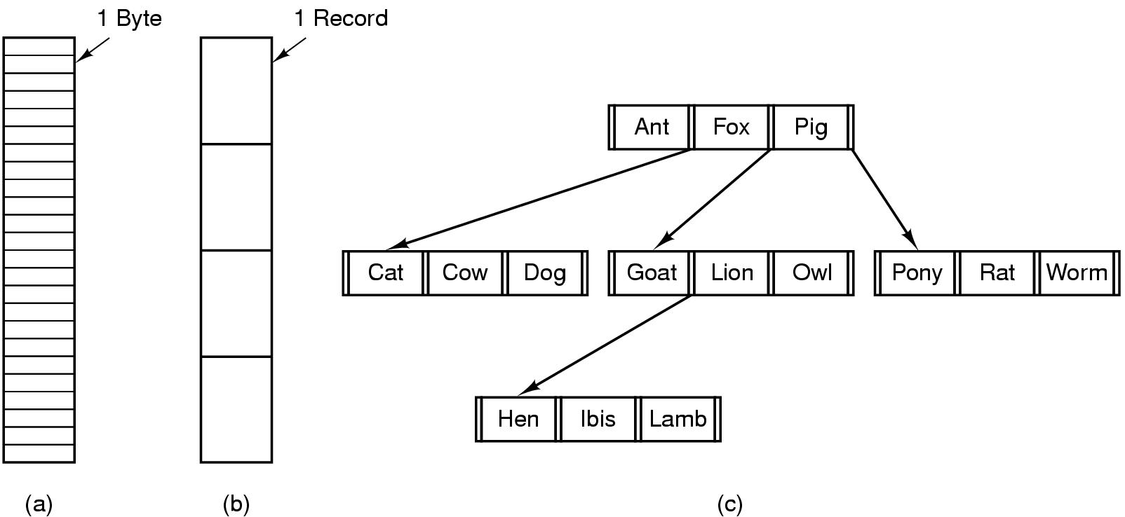
Internal File Structure
Byte Sequence: unstructured
Record sequence: r/w in records, relates to sector sizes
Complex structures, e.g. tree
  - Data stored in variable length records; OS specific meaning of each file

Slide 7
File Access
Sequential access
  read all bytes/records from the beginning
  cannot jump around, could rewind or forward
  convenient when medium was magnetic tape
Random access
  bytes/records read in any order
  essential for database systems

Slide 8
File Attributes
File-specific info maintained by the OS
  File size, modification date, creation time, etc.
  Varies a lot across different OSes
Some examples:
  Name – only information kept in human-readable form
  Identifier – unique tag (number) identifies file within file system
  Type – needed for systems that support different types
  Location – pointer to file location on device
  Size – current file size
  Protection – controls who can do reading, writing, executing
  Time, date, and user identification – data for protection, security, and usage monitoring

Slide 9
Basic File System Operations
Create a file
Write to a file
Read from a file
Seek to somewhere in a file
Delete a file
Truncate a file

Slide 10

FS on disk
Could use entire disk space for a FS, but
  A system could have multiple FSes
  Want to use some disk space for swap space
Disk divided into partitions, slices or minidisks
  Chunk of storage that holds a FS is a volume
  Directory structure maintains info of all files in the volume
    Name, location, size, type, …

Slide 11
Directories
Directories/folders keep track of files
  Is a symbol table that translates file names to directory entries
  Usually are themselves files
How to structure the directory to optimize all of the following:
  Search a file
  Create a file
  Delete a file
  List directory
  Rename a file
  Traversing the FS
Directory
Files
F 1
F 2
F 3
F 4
F n

Slide 12

Single-level Directory
One directory for all files in the volume
  Called root directory
  Used in early PCs, even the first supercomputer CDC 6600
Pros: simplicity, ability to quickly locate files
Cons: inconvenient naming (uniqueness, remembering all)

Slide 13

Two-level directory
Each user has a separate directory
Solves name collision, but what if user has lots of files
May not allow a user to access other users’ files

Slide 14

Tree-structured Directory
Directory is now a tree of arbitrary height
  Directory contains files and subdirectories
  A bit in directory entry differentiates files from subdirectories

Slide 15
Path Names
To access a file, the user should either:
  Go to the directory where file resides, or
  Specify the path where the file is
Path names are either absolute or relative
  Absolute: path of file from the root directory
  Relative: path from the current working directory
Most OSes have two special entries in each directory:
  “.” for current directory and “..” for parent

Slide 16

Acyclic Graph Directories
Share subdirectories or files

Slide 17
Acyclic Graph Directories
How to implement shared files and subdirectories:
  Why not copy the file?
  New directory entry, called Link (used in UNIX)
    Link is a pointer to another file or subdirectory
    Links are ignored when traversing FS
    ln in UNIX, fsutil in Windows for hard links
    ln –s in UNIX, shortcuts in Windows for soft links
Issues?
  Two different names (aliasing)
  If dict deletes count ⇒ dangling pointer
    Keep backpointers of links for each file
    Leave the link, and delete only when accessed later
    Keep reference count of each file

Slide 18
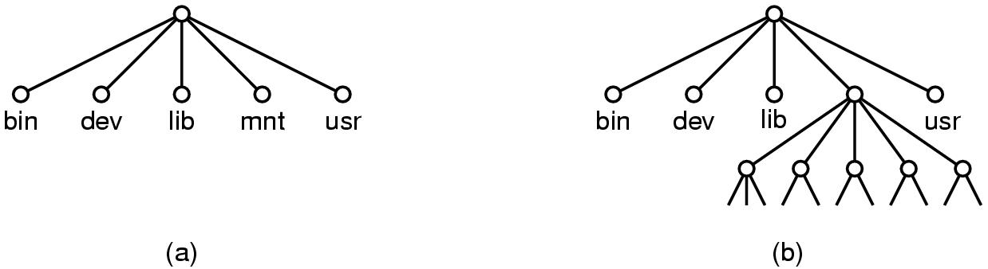
File System Mounting
Mount allows two FSes to be merged into one
  For example you insert your floppy into the root FS
mount(“/dev/fd0”, “/mnt”, 0)

Slide 19
Remote file system mounting
Same idea, but file system is actually on some other machine
Implementation uses remote procedure call
  Package up the user’s file system operation
  Send it to the remote machine where it gets executed like a local request
  Send back the answer
Very common in modern systems

Slide 20
File Protection
File owner/creator should be able to control:
  what can be done
  by whom
Types of access
  Read
  Write
  Execute
  Append
  Delete
  List

Slide 21
Categories of Users
Individual user
  Log in establishes a user-id
  Might be just local on the computer or could be through interaction with a network service
Groups to which the user belongs
  For example, “einar” is in “facres”
  Again could just be automatic or could involve talking to a service that might assign, say, a temporary cryptographic key

Slide 22
Linux Access Rights
Mode of access: read, write, execute
Three classes of users RWX
a) owner access 7 ⇒ 1 1 1
RWX
b) group access 6 ⇒ 1 1 0
RWX
c) public access 1 ⇒ 0 0 1
For a particular file (say game) or subdirectory, define an appropriate access.
owner
group
public
chmod
761
game

Slide 23
Issues with Linux
Just a single owner, a single group and the public
  Pro: Compact enough to fit in just a few bytes
  Con: Not very expressive
Access Control List: This is a per-file list that tells who can access that file
  Pro: Highly expressive
  Con: Harder to represent in a compact way

Slide 24

XP ACLs

Slide 25
Security and Remote File Systems
Recall that we can “mount” a file system
  Local: File systems on multiple disks/volumes
  Remote: A means of accessing a file system on some other machine
    Local stub translates file system operations into messages, which it sends to a remote machine
    Over there, a service receives the message and does the operation, sends back the result
    Makes a remote file system look “local”

Slide 26
Unix Remote File System Security
Since early days of Unix, NFS has had two modes
  Secure mode: user, group-id’s authenticated each time you boot from a network service that hands out temporary keys
  Insecure mode: trusts your computer to be truthful about user and group ids
Most NFS systems run in insecure mode!
  Because of US restrictions on exporting cryptographic code…

Slide 27
Spoofing
Question: what stops you from “spoofing” by building NFS packets of your own that lie about id?
Answer?
  In insecure mode… nothing!
  In fact people have written this kind of code
  Many NFS systems are wide open to this form of attack, often only the firewall protects them

Slide 28
File System Implementation
How exactly are file systems implemented?
  Comes down to: how do we represent
    Volumes/partitions
    Directories (link file names to file “structure”)
    The list of blocks containing the data
    Other information such as access control list or permissions, owner, time of access, etc?
  And, can we be smart about layout?

Slide 29
Implementing File Operations
Create a file:
  Find space in the file system, add directory entry.
Writing in a file:
  System call specifying name & information to be written. Given name, system searches directory structure to find file. System keeps write pointer to the location where next write occurs, updating as writes are performed
Reading a file:
  System call specifying name of file & where in memory to stick contents. Name is used to find file, and a read pointer is kept to point to next read position. (can combine write & read to current file position pointer)
Repositioning within a file:
  Directory searched for appropriate entry & current file position pointer is updated (also called a file seek)

Slide 30
Implementing File Operations
Deleting a file:
  Search directory entry for named file, release associated file space and erase directory entry
Truncating a file:
  Keep attributes the same, but reset file size to 0, and reclaim file space.

Slide 31
Other file operations
Most FS require an open() system call before using a file.
OS keeps an in-memory table of open files, so when reading a writing is requested, they refer to entries in this table.
On finishing with a file, a close() system call is necessary. (creating & deleting files typically works on closed files)
What happens when multiple files can open the file at the same time?

Slide 32
Multiple users of a file
OS typically keeps two levels of internal tables:
Per-process table
  Information about the use of the file by the user (e.g. current file position pointer)
System wide table
  Gets created by first process which opens the file
  Location of file on disk
  Access dates
  File size
  Count of how many processes have the file open (used for deletion)

Slide 33
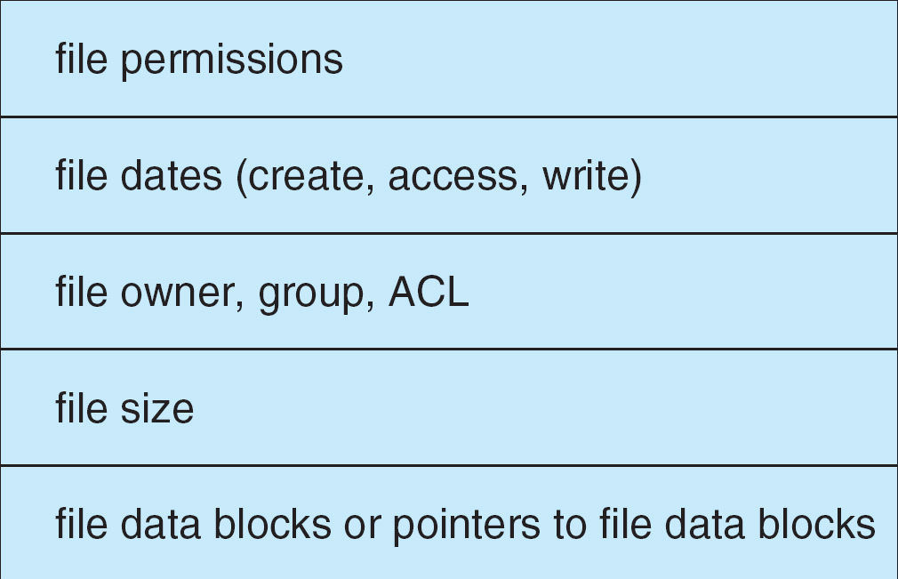
The File Control Block (FCB)
FCB has all the information about the file
  Linux systems call these inode structures

Slide 34

Files Open and Read

Slide 35
Virtual File Systems
Virtual File Systems (VFS) provide an object-oriented way of implementing file systems.
VFS allows the same system call interface (the API) to be used for different types of file systems.
The API is to the VFS interface, rather than any specific type of file system.

Slide 36


Slide 37
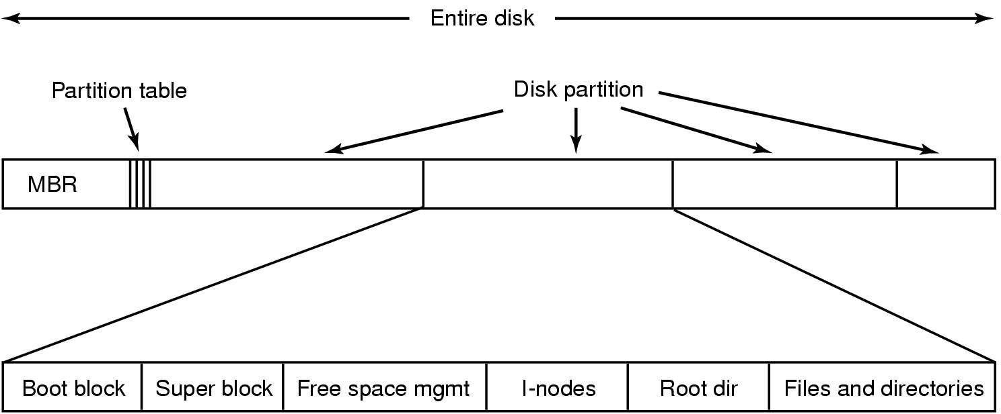
File System Layout
File System is stored on disks
  Disk is divided into 1 or more partitions
  Sector 0 of disk called Master Boot Record
  End of MBR has partition table (start & end address of partitions)
First block of each partition has boot block
  Loaded by MBR and executed on boot

Slide 38
Storing Files
Files can be allocated in different ways:
  Contiguous allocation
    All bytes together, in order
  Linked Structure
    Each block points to the next block
  Indexed Structure
    An index block contains pointer to many other blocks
  Rhetorical Questions -- which is best?
    For sequential access? Random access?
    Large files? Small files? Mixed?

Slide 39

Contiguous Allocation
Allocate files contiguously on disk

Slide 40
Contiguous Allocation
Pros:
  Simple: state required per file is start block and size
  Performance: entire file can be read with one seek
Cons:
  Fragmentation: external is bigger problem
  Usability: user needs to know size of file
Used in CDROMs, DVDs

Slide 41

Linked List Allocation
Each file is stored as linked list of blocks
  First word of each block points to next block
  Rest of disk block is file data

Slide 42
Linked List Allocation
Pros:
  No space lost to external fragmentation
  Disk only needs to maintain first block of each file
Cons:
  Random access is costly
  Overheads of pointers.

Slide 43
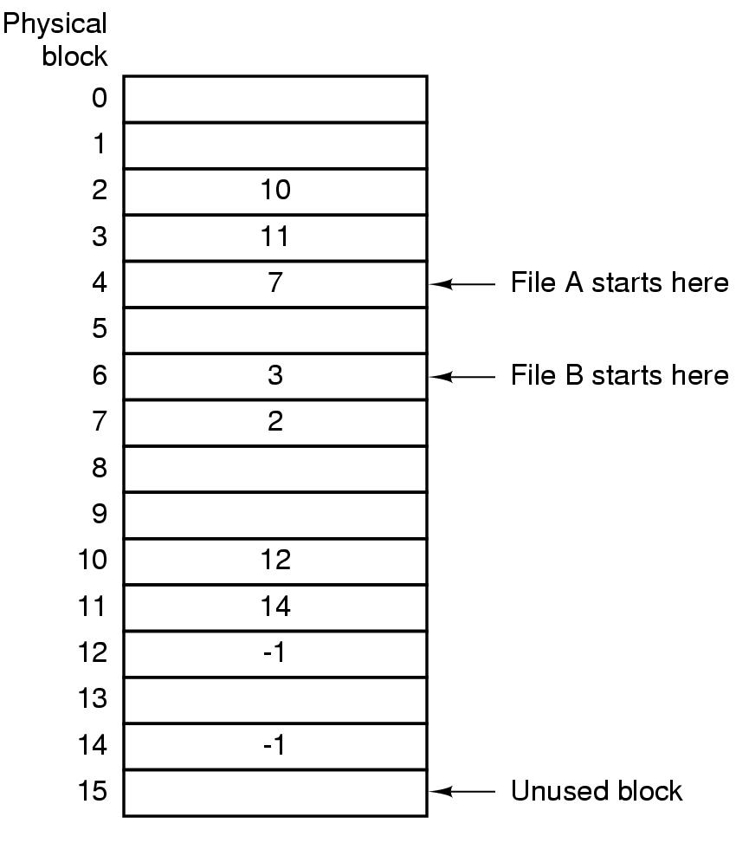
MS-DOS file system
Implement a linked list allocation using a table
  Called File Allocation Table (FAT)
  Take pointer away from blocks, store in this table

Slide 44
FAT Discussion
Pros:
  Entire block is available for data
  Random access is faster than linked list.
Cons:
  Many file seeks unless entire FAT is in memory
    For 20 GB disk, 1 KB block size, FAT has 20 million entries
    If 4 bytes used per entry ⇒ 80 MB of main memory required for FS

Slide 45

Indexed Allocation
Index block contains pointers to each data block
Pros?
Cons?

Slide 46

UFS - Unix File System

Slide 47
Unix inodes
If data blocks are 4K …
  First 48K reachable from the inode
  Next 4MB available from single-indirect
  Next 4GB available from double-indirect
  Next 4TB available through the triple-indirect block
Any block can be found with at most 3 disk accesses

Slide 48
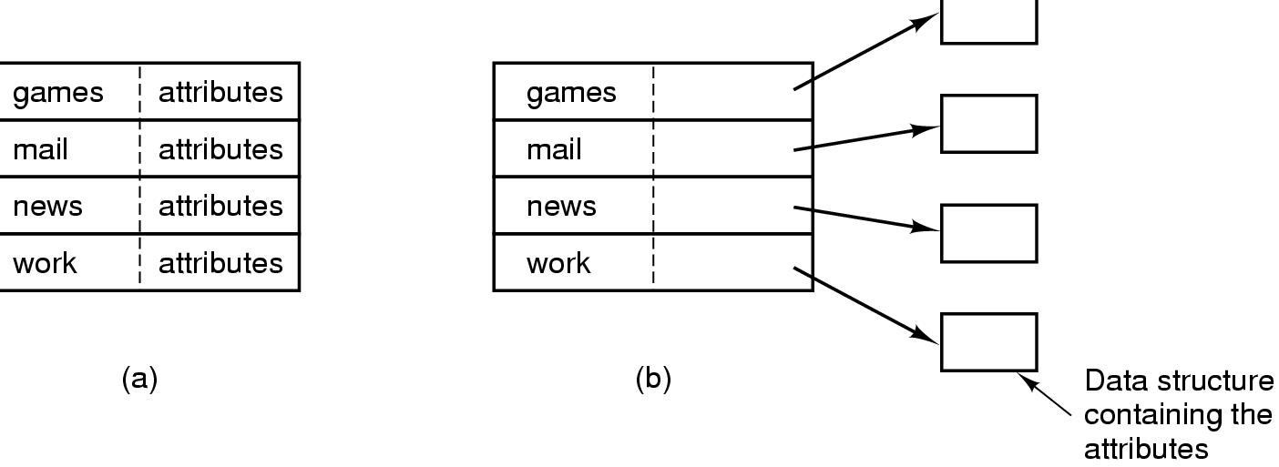
Implementing Directories
When a file is opened, OS uses path name to find dir
  Directory has information about the file’s disk blocks
    Whole file (contiguous), first block (linked-list) or I-node
  Directory also has attributes of each file
Directory: map ASCII file name to file attributes & location
2 options: entries have all attributes, or point to file I-node

Slide 49
Directory Search
Simple Linear search can be slow
Alternatives:
  Use a per-directory hash table
    Could use hash of file name to store entry for file
    Pros: faster lookup
    Cons: More complex management
  Caching: cache the most recent searches
    Look in cache before searching FS

Slide 50
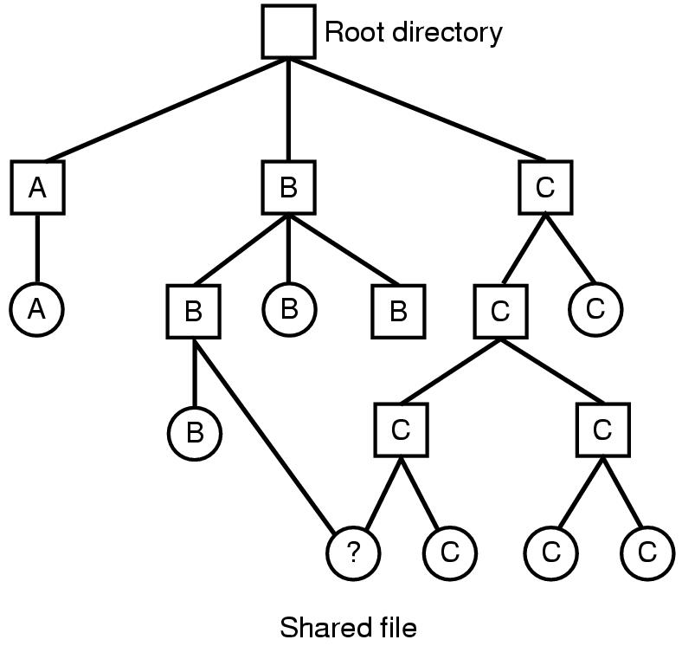
Shared Files
If B wants to share a file owned by C
  One Solution: copy disk addresses in B’s directory entry
  Problem: modification by one not reflected in other user’s view

Slide 51
Hard vs Soft Links
Inode
File name
Inode#
Foo.txt
2433
Inode
#2433
Hard.lnk
2433

Slide 52
Hard vs Soft Links
Soft.lnk
43234
Inode
#43234
/path/to/Foo.txt
..and then redirects to Inode #2433 at open() time..
Foo.txt
2433
Inode
#2433

Slide 53
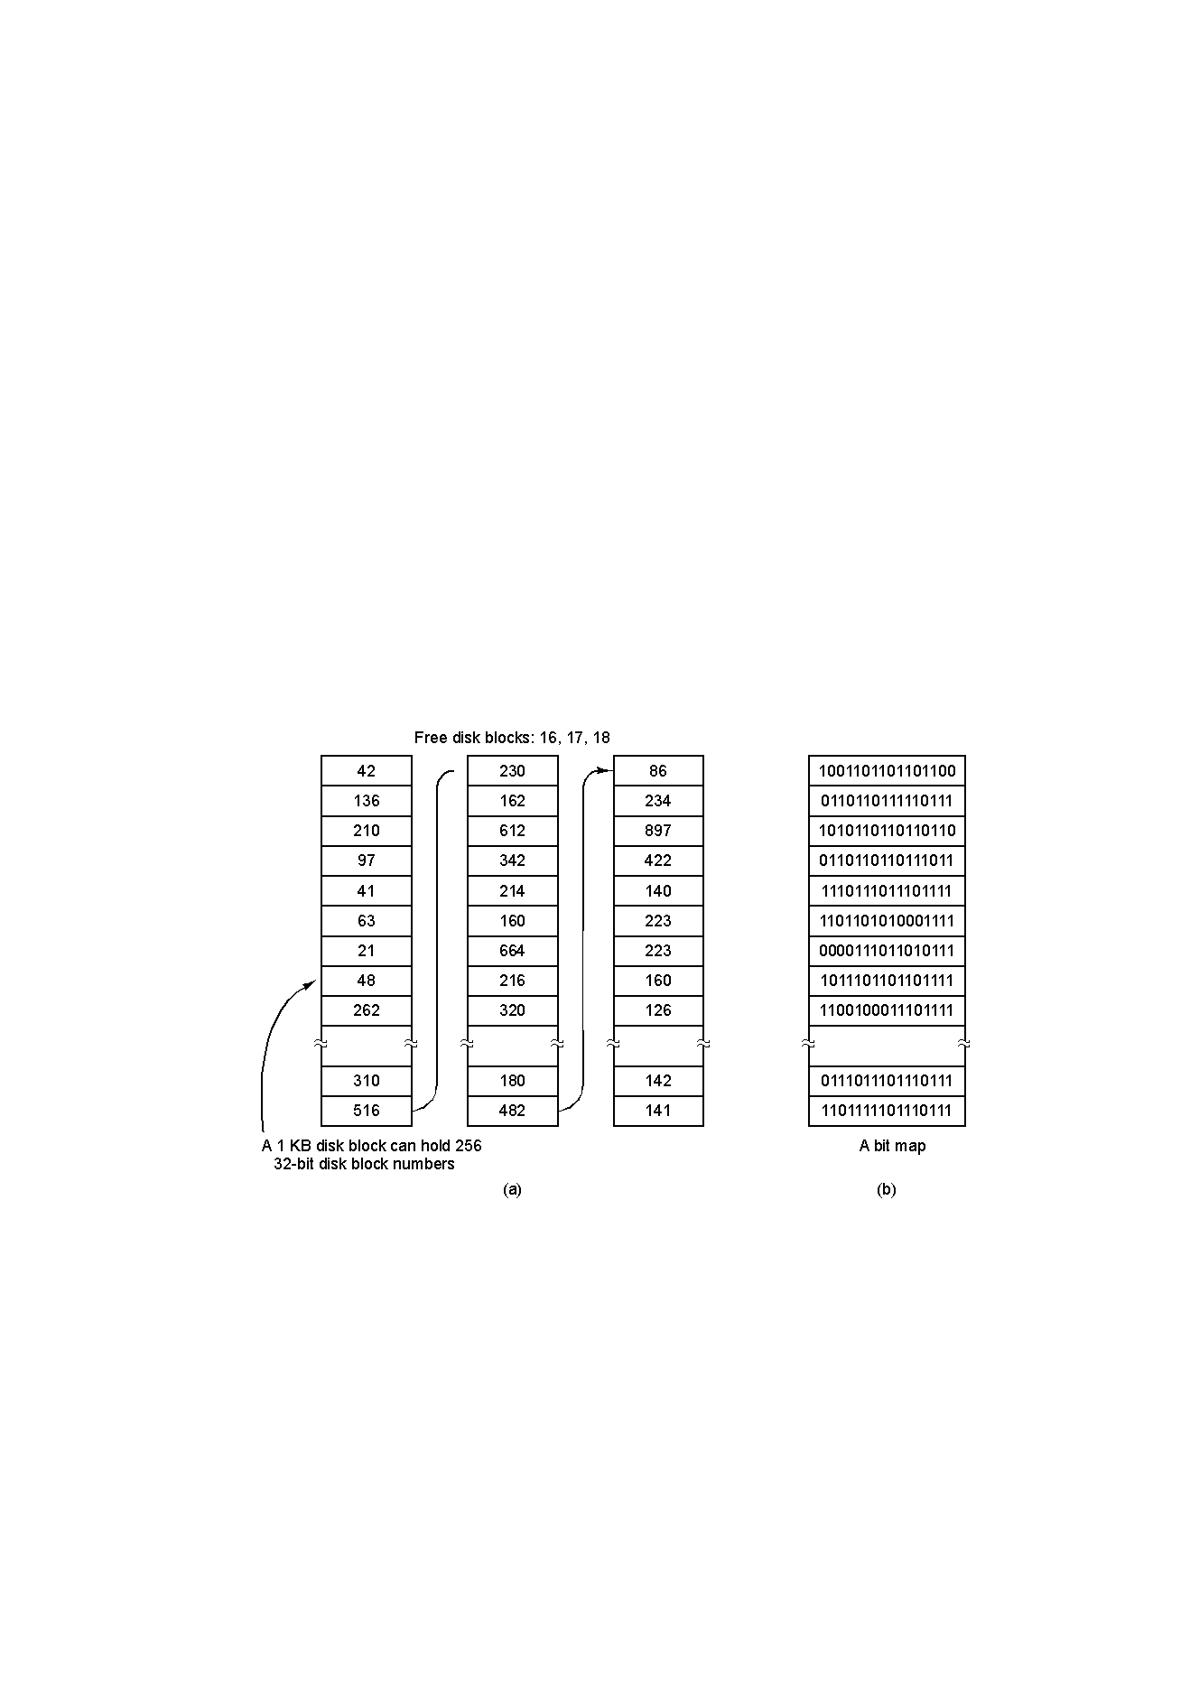
Managing Free Disk Space
2 approaches to keep track of free disk blocks
  Linked list and bitmap approach

Slide 54
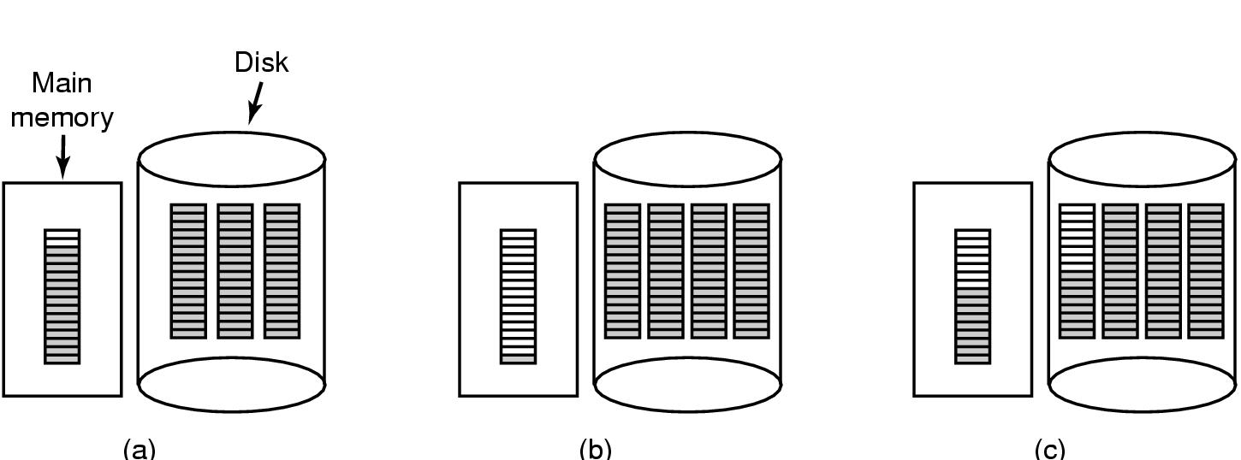
Tracking free space
Storing free blocks in a Linked List
  Only one block need to be kept in memory
  Bad scenario: Solution (c)
Storing bitmaps
  Lesser storage in most cases
  Allocated disk blocks are closer to each other

Slide 55
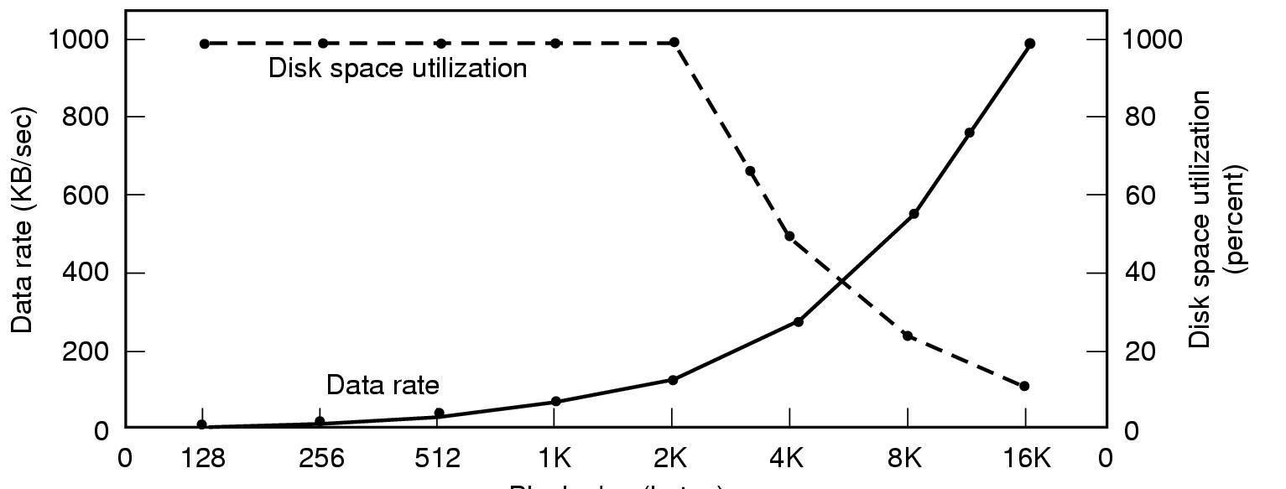
Disk Space Management
Files stored as fixed-size blocks
What is a good block size? (sector, track, cylinder?)
  If 131,072 bytes/track, rotation time 8.33 ms, seek time 10 ms
  To read k bytes block: 10+ 4.165 + (k/131072)*8.33 ms
  Median file size: 2 KB
Block size

Slide 56
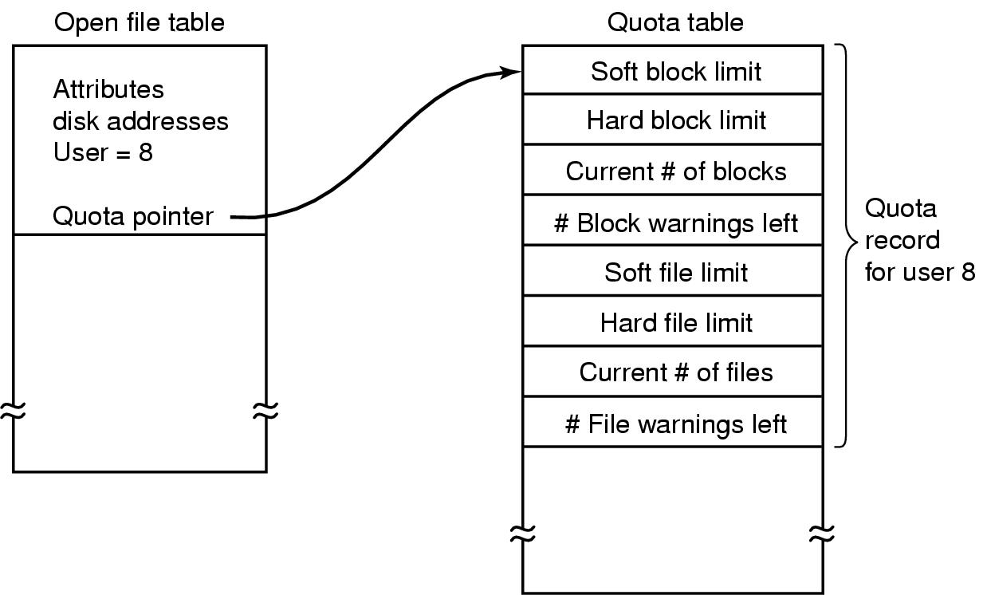
Managing Disk Quotas
Sys admin gives each user max space
  Open file table has entry to Quota table
  Soft limit violations result in warnings
  Hard limit violations result in errors
  Check limits on login

Slide 57
Efficiency and Performance
Efficiency dependent on:
  disk allocation and directory algorithms
  types of data kept in file’s directory entry
Performance
  disk cache – separate section of main memory for frequently used blocks
  free-behind and read-ahead – techniques to optimize sequential access
  improve PC performance by dedicating section of memory as virtual disk, or RAM disk

Slide 58
File System Consistency
System crash before modified files written back
  Leads to inconsistency in FS
  fsck (UNIX) & scandisk (Windows) check FS consistency
Algorithm:
  Build 2 tables, each containing counter for all blocks (init to 0)
    1st table checks how many times a block is in a file
    2nd table records how often block is present in the free list
      >1 not possible if using a bitmap
  Read all i-nodes, and modify table 1
  Read free-list and modify table 2
  Consistent state if block is either in table 1 or 2, but not both

Slide 59
A changing problem
Consistency used to be very hard
  Problem was that driver implemented C-SCAN and this could reorder operations
  For example
    Delete file X in inode Y containing blocks A, B, C
    Now create file Z re-using inode Y and block C
  Problem is that if I/O is out of order and a crash occurs we could see a scramble
    E.g. C in both X and Z… or directory entry for X is still there but points to inode now in use for file Z

Slide 60
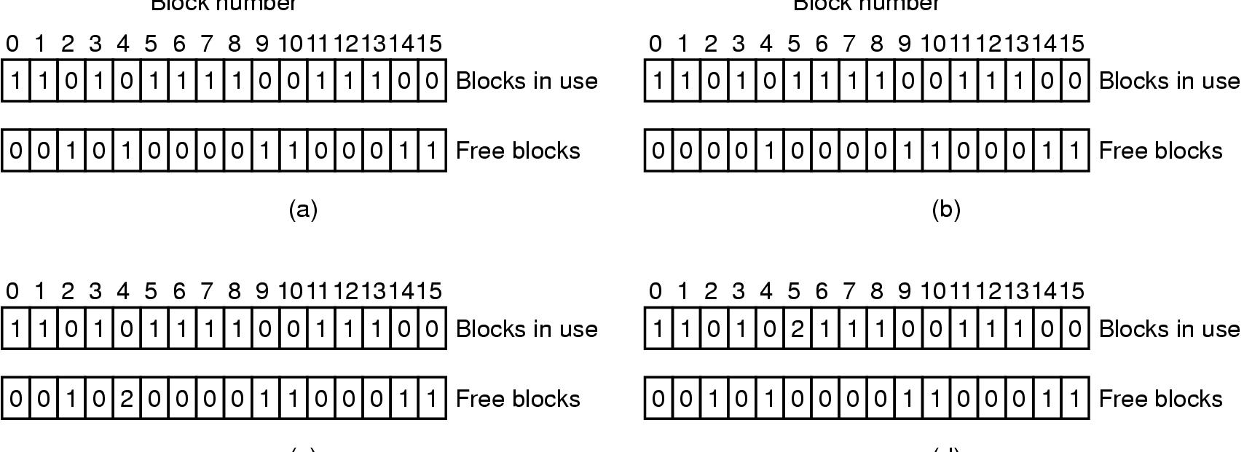
Inconsistent FS examples
Consistent
missing block 2: add it to free list
Duplicate block 4 in free list: rebuild free list
Duplicate block 5 in data list: copy block and add it to one file

Slide 61
Check Directory System
Use a per-file table instead of per-block
Parse entire directory structure, starting at the root
  Increment the counter for each file you encounter
  This value can be >1 due to hard links
  Symbolic links are ignored
Compare counts in table with link counts in the i-node
  If i-node count > our directory count (wastes space)
  If i-node count < our directory count (catastrophic)

Slide 62
Log Structured File Systems
Log structured (or journaling) file systems record each update to the file system as a transaction
All transactions are written to a log
  A transaction is considered committed once it is written to the log
  However, the file system may not yet be updated

Slide 63
Log Structured File Systems
The transactions in the log are asynchronously written to the file system
  When the file system is modified, the transaction is removed from the log
If the file system crashes, all remaining transactions in the log must still be performed
E.g. ReiserFS, XFS, NTFS, etc..

Slide 64
FS Performance
Access to disk is much slower than access to memory
  Optimizations needed to get best performance
3 possible approaches: caching, prefetching, disk layout
Block or buffer cache:
  Read/write from and to the cache.

Slide 65
Block Cache Replacement
Which cache block to replace?
  Could use any page replacement algorithm
  Possible to implement perfect LRU
    Since much lesser frequency of cache access
    Move block to front of queue
  Perfect LRU is undesirable. We should also answer:
    Is the block essential to consistency of system?
    Will this block be needed again soon?
When to write back other blocks?
  Update daemon in UNIX calls sync system call every 30 s
  MS-DOS uses write-through caches

Slide 66

Other Approaches
Pre-fetching or Block Read Ahead
  Get a block in cache before it is needed (e.g. next file block)
  Need to keep track if access is sequential or random
Reducing disk arm motion
  Put blocks likely to be accessed together in same cylinder
    Easy with bitmap, possible with over-provisioning in free lists
  Modify i-node placements

Slide 67
Storage Area Networks (SANs)
New generation of architectures for managing storage in massive data centers
  For example, Google is said to have 50,000-200,000 computers in various centers
  Amazon is reaching a similar scale
A SAN system is a collection of file systems with tools to help humans administer the system

Slide 68
Examples of SAN issues
Where should a file be stored
  Many of these systems have an indirection mechanism so that a file can move from volume to volume
  Allows files to migrate, e.g. from a slow server to a fast one or from long term storage onto an active disk system
Eco-computing: systems that seek to minimize energy in big data centers

Slide 69
Examples of SAN issues
Disk-to-disk backup
  Might want to do very fast automated backups
  Ideally, can support this while the disk is actively in use
Easiest if two disks are next to each other
Challenge: back up entire data center in New York at site in Kentucky
  US Dept of Treasury e-Cavern

